Slide 1


Slide 2


Identifying Medical Research Funding Portals
Dr. Ganesh R, MDS,PGCOI.
Professor & HOD,
Department of Public Health Dentistry
Priyadarshini Dental College & Hospital

Slide 3

Overview of Various Schemes
Research Funding Agencies

Slide 4

Research Funding Agencies in India
Indian Council of Medical Research (ICMR) &
Department of Health Research (DHR)
Science and Engineering Research Board (SERB)
Department of Science and Technology (DST)
Department of Biotechnology (BIRAC)
University Grants Commission (UGC)
Specialized Dental Society grants
Tamil Nadu state council for science and technology

Slide 5
Indian Council of Medical Research (ICMR)
&
Department of Health Research (DHR)

Slide 6
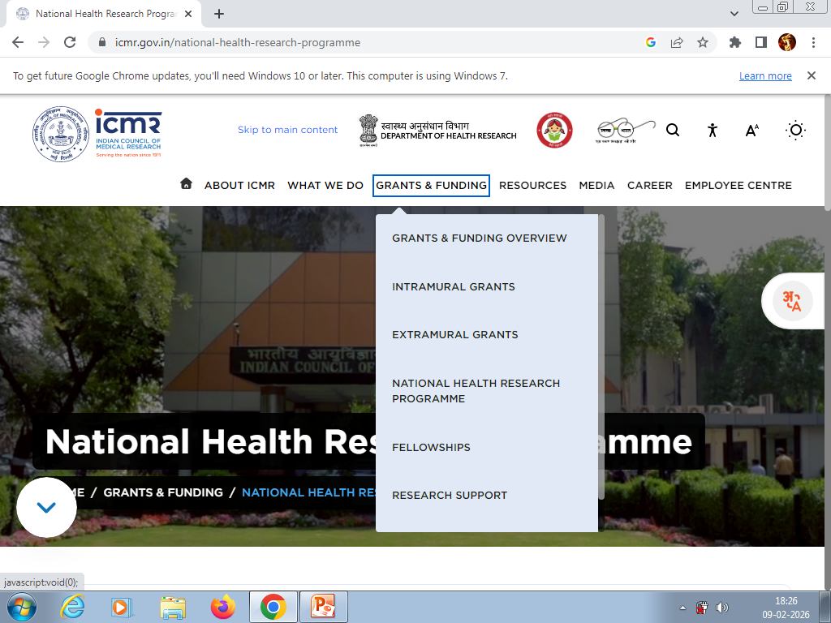

Slide 7
Indian Council of Medical Research (ICMR)
Intramural Grants
Extramural Grants
National Health Research Programme
Fellowships
Research Support

Slide 8

National Health Research Programme
1. Antimicrobial Resistance (AMR)
2. One Health
3. Tuberculosis
4. Vector-borne Diseases
5. Cancer
6. Ambulatory Non-Communicable Disease (NCD) Care,
7. Mental Health
8. Anemia, Stunting and Wasting
9. Neonatal Mortality
10. Acute Emergency Care
11. Oral Health
Notes:
Large decisive multi-state projects will receive funding, with a strong emphasis on addressing programme needs, 33 projects, upto 25 crores

Slide 9
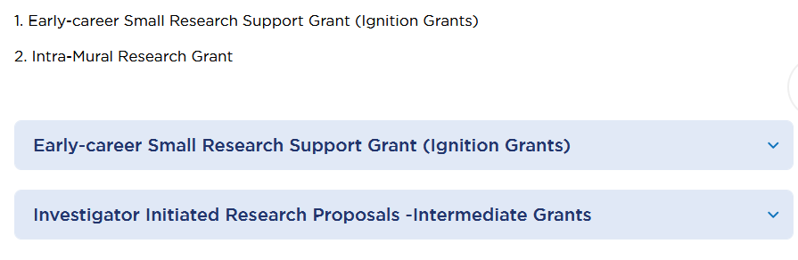
Intramural Grants
For ICMR scientists

Slide 10

ICMR EXTRAMURAL GRANTS
Small Grant
Intermediate Grant
Advanced Research Grant

Slide 11
Investigator Initiated Research Proposals - Small Grant
Upto 2 crores
4 years
Multidisciplinary projects addressing priority diseases and conditions.
Proposals that build on findings from previous ICMR grants will be prioritized for funding.
Notes:
Funding: Upto 2 crores per project
Duration: Maximum 4 years
Projects that are clearly defined and time-limited, aiming to achieve specific, measurable objectives aligned with ICMR priorities.
Preference will be given to multidisciplinary projects addressing priority diseases and conditions.
Additionally, Research proposals that build on findings from previous ICMR grants will be prioritized for funding.

Slide 12
Investigator Initiated Research Proposals - Intermediate Grant
2-8 crores per project
4 years
Notes:
Funding: Between 2-8 crores per project
Duration: Maximum 4 years
Funding for projects that focus on addressing key health issues by validating or evaluating interventions with established proof of concept.
These studies must build on documented evidence and aim for significant impact, contributing to prevention, diagnosis, treatment, or rehabilitation.
Expected outcomes include patents, commercial products, or influential publications.
Multi-site studies are particularly encouraged to maximize the project's reach and effectiveness.

Slide 13
Centre for Advanced Research (CAR)
Upto 15 crores
5 years
Advanced studies by experienced research teams.
Identify priority areas through an open call for proposals
Notes:
Funding: Upto 15 crores per CAR
Duration: 5 years
Funding to Centres for Advanced Research (CAR) to support advanced studies by experienced research teams.
Preference will be given to teams focusing on the prevention, screening, diagnosis, treatment, or rehabilitation of diseases or conditions.
ICMR will identify priority areas through an open Call for Proposals

Slide 14

Research Support
Adjuvant Faculty program
ICMR Emeritus Scientist
ICMR Chairs
Notes:
Emeritus: to apply for becoming ICMR emeritus Scientist
ICMR Chair: see next page
Adjuvant Faculty: to invite the researchers/faculties from other national & international organizations to get associated with ICMR, through the Adjunct Faculty program.

Slide 15
Purpose/Objectives of the ICMR Chair
i. “Think Tank” for ICMR.
ii. To advise DG ICMR for improving ICMR’s intramural and extramural research programs.
iii. To mentor ICMR scientists
iv. To facilitate workshops for proposal & protocol development, data analysis & interpretation and manuscript preparation.
v. To undertake independent activities that help scientists at any Indian institutes to conceptualize, plan and conduct world class medical research.

Slide 16





Slide 17
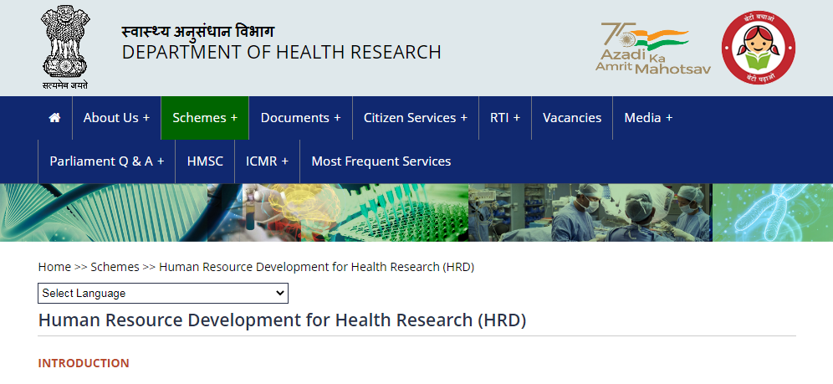

Slide 18
COMPONENTS OF SCHEME
Short-Term Studentship (STS)
MD/MS/DM/MCH/DNB/DrNB/MDS Thesis Support Program
MD/MS-Ph.D. Program
International Travel Grant Support For Non-DHR/ICMR Scientists & Researchers
Workshops Funding Grant In Biomedical Research
Non-medical fellowships for Ph.D.-NET (BRET)

Slide 19
COMPONENTS OF SCHEME
Short-Term Fellowship Abroad & at Indian Institutes
Long-Term Fellowship Abroad & at Indian Institutes
Women Scientists Fellowship
Support To Institutions and Scientific Professionals /Bodies / Associations
Start-Up Grant for Research Projects
Biomedical research grant for NRI/OCI/PIO
Fellowship for best achievement in biomedical research

Slide 20


SHORT-TERM STUDENTSHIP (STS)

Slide 21
SHORT-TERM STUDENTSHIP (STS)
1st & 2nd year MBBS/BDS
Guide: regular full-time faculty members
6 months
Conceptualize, develop & submission ; Collection of data Analysis of data; Preparation & submission
Rs. 60,000/- (w.e.f. 2024) for six months (Rs 15000 + Rs 15000 + Rs 30000)
Notes:
Student: 1st and 2nd Professional (Prof.) year MBBS/BDS student
Guide: Only regular full-time faculty members working in the same Medical/Dental College
Total tenure of 6 months
Conceptualize, develop & submission ; Collection of data Analysis of data; Preparation & submission
Stipend to the Fellow: Rs. 60,000/- (w.e.f. 2024) for six months of research work along with an e-certificate (Rs 15000 + Rs 15000 + Rs 30000)

Slide 22


MD/MS/DM/MCh/DNB/DrNB/ MDS THESIS SUPPORT PROGRAM

Slide 23
MD/MS/DM/MCh/DNB/DrNB/ MDS THESIS SUPPORT PROGRAM
Medical/dental post-graduation students
Within one year of PG admission/joining.
Applicant must be an Indian citizen
45 years of age
3 years
Rs. One lakh (Rs 50,000 + Rs 50,000)
Notes:
Medical/dental graduates who are admitted to the post-graduation courses in Medical/dental institute
To apply within one year of PG admission/joining.
Applicant must be an Indian citizen.
Upper age limit: 45 years of age (as on the last date of application).
3 years tenure from the date of issue of the Award letter
Rs. One lakh one-time grant which will be given in two installments viz. 1st installment= Rs.25,000/- & 2nd installment= Rs. 75,000/-).

Slide 24


MD/MS-Ph.D. Program
CATEGORY 1
CATEGORY 2

Slide 25

Category 1:Medical PhD Programme
MBBS/BDS graduates or post-graduates viz. MD/MS/DM/MCh/DNB/DrNB/MDS pursuing students Or degree holders
45 years of age
Notes:
MBBS/BDS graduates or post-graduates viz. MD/MS/DM/MCh/DNB/DrNB/MDS pursuing students Or degree holders in any of the stated post-graduate degrees from NMC/NBE /DCI - recognized medical/dental colleges in India.
Upper age limit: 45 years of age (as on the last date of application)

Slide 26

Category 2- Young Medical Faculty- PhD Programme
Medical faculty holding MD/MS/DM/MCh/DNB/DrNB/MDS degree
Full time regular employee with at least one year of service at or UGC recognized research universities, research institutes of National Importance.
45 years of age
Notes:
Medical faculty holding MD/MS/DM/MCh/DNB/DrNB/MDS degree.
Full time regular employee with at least one year of service at NMC / DCI recognized medical colleges or UGC recognized research universities, research institutes of National Importance.
Upper age limit: 45 years of age (as on the last date of application).

Slide 27

Financial support
Medical Ph.D Programme (Category 1):
Rs. 83,000 per month - MBBS/BDS (5 years)
Rs.96,000 per month -MD/MS/DM/MCh/DNB/DrNB/MDS ( 2 years)
Rs. 10 lakhs/per year for the duration of five years or completion of Ph.D.whichever is earlier.
Young Medical Faculty Ph.D. program (Category 2):
No stipend will be paid.
Rs. 10 lakhs/per year for the duration of five years or completion of Ph.D. whichever is earlier.
Notes:
Medical Ph.D Programme (Category 1):
Rs. 83,000 per month will be paid to MBBS/BDS graduates until completion of Ph.D. course or up to 5 years, whichever is earlier and Rs.96,000 per month will be paid to MD/MS/DM/MCh/DNB/DrNB/MDS degree holders until completion of Ph.D. degree or up to 2 years, whichever is earlier.
Rs. 10 lakhs/per year for the duration of five years or completion of Ph.D.whichever is earlier.
Young Medical Faculty Ph.D. program (Category 2):
No stipend will be paid.
Rs. 10 lakhs/per year for the duration of five years or completion of Ph.D. whichever is earlier.

Slide 28


SHORT-TERM FELLOWSHIP ABROAD

Slide 29
SHORT-TERM FELLOWSHIP ABROAD (15 days-3 months)
Field of biomedical research and technology
Citizen of India and working in the country
M.D/M.S/Ph.D degree (M.D./ M.S./ M.D.S. or MBBS/BDS/ MVSc./ M.Sc./M.Pharma/M.Tech or equivalent with Ph.D
At least fifteen years of experience (for availing the fellowship for 15 days)
At least ten years of experience (for availing the fellowship for 1-3months)
Below 57 years
Notes:
Field of biomedical research and technology
Citizen of india and working in the country
Possess an M.D/M.S/Ph.D degree (M.D./ M.S./ M.D.S. or MBBS/BDS/ MVSc./ M.Sc./M.Pharma/M.Tech or equivalent with Ph.D. in health /biomedical research) with at least fifteen years of experience (for availing the fellowship for 15 days) and atleast ten years of experience (for availing the fellowship for 1-3months) in teaching/research in a recognized Institute

Slide 30

SHORT-TERM FELLOWSHIP ABROAD (15 days-3 months)
Stipend - US$ 3000 per month
Return economy class airfare
Rs. 75,000/- cost of visa, SEVIS fee, taxi charges
Rs. 20,000/- overseas mediclaim insurance expenses
Notes:
A stipend of US$ 3000 per month which includes accommodation and other expenses
Return economy class excursion airfare through shortest route
A of maximum of Rs. 75,000/- which includes the cost of visa, SEVIS fee, taxi charges from place of duty to airport and back.
A maximum of Rs. 20,000/- for overseas mediclaim insurance expenses

Slide 31

LONG-TERM FELLOWSHIP ABROAD
(6-12 months)

Slide 32

LONG-TERM FELLOWSHIP ABROAD (6-12 months)
Three years teaching/research experience in a recognized Institute
Below 45 years as on last date of receipt of application
Notes:
Three years teaching/research experience in a recognized Institute
Below 45 years as on last date of receipt of application

Slide 33


START-UP GRANT FOR RESEARCH PROJECTS

Slide 34
START-UP GRANT FOR RESEARCH PROJECTS
Biomedical researchers who have undergone training in Indian/foreign institutes supported by DHR.
Up to of Rs. 16 Lakhs per year up to Rs. 50 Lakhs per research project
For three years
Notes:
Is meant to support biomedical researchers who have undergone training in Indian/foreign institutes supported by DHR.
up to of Rs. 16 Lakhs per year up to Rs. 50 Lakhs per research project for three years

Slide 35
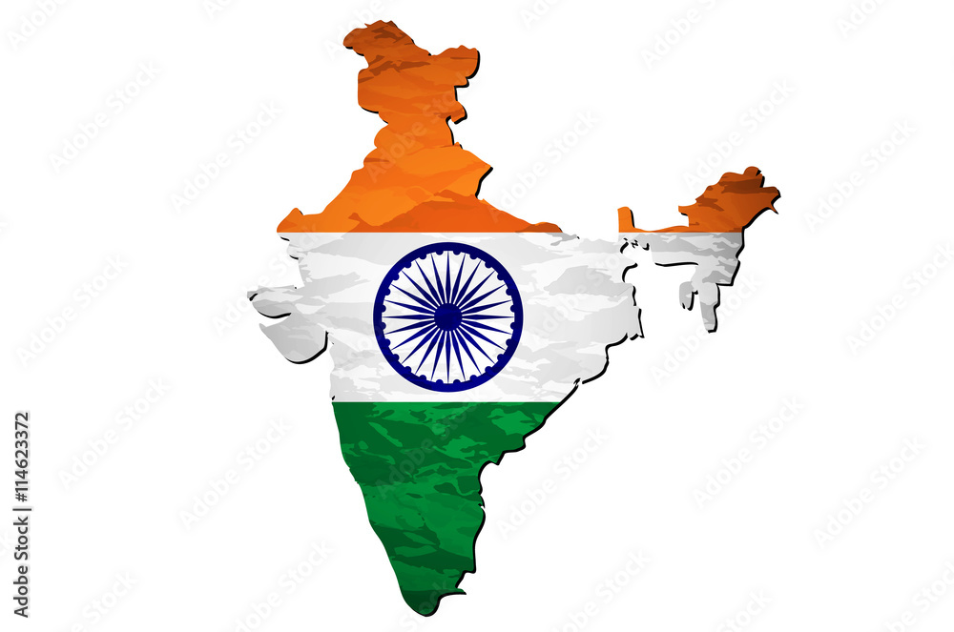
SHORT-TERM & LONG TERM FELLOWSHIP AT INDIAN INSTITUTES (1-3 months; 6-12 months)

Slide 36
SHORT-TERM & LONG TERM FELLOWSHIP AT INDIAN INSTITUTES (1-3 months; 6-12 months)
Not above the age of 45 years
Faculty / Researcher having at least three years of experience in the college/institute as a regular employee
They should hold M.D./ M.S./ M.D.S. or MBBS/BDS/M. VSc./ M.Sc./M.Pharma/M.Tech or equivalent with Ph.D. in health / biomedical research
Stipend up to Rs. 40,000 per month
Contingency Rs 50000/-
Notes:
not above the age of 45 years
Faculty / Researcher having at least three years of experience in the college/institute as a regular employee
They should hold M.D./ M.S./ M.D.S. or MBBS/BDS/M. VSc./ M.Sc./M.Pharma/M.Tech or equivalent with Ph.D. in health / biomedical research
stipend up to Rs. 40,000 per month will be provided for a period of stay in the host institute, which is at a different station from the parent Institute
Contigency Rs 50000

Slide 37

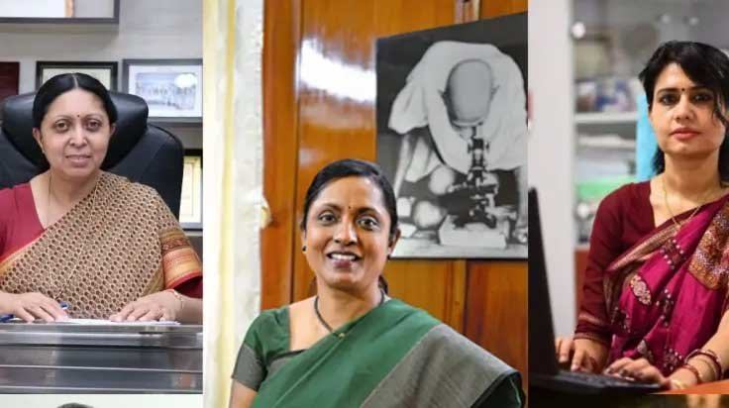
WOMEN SCIENTISTS FELLOWSHIP

Slide 38
WOMEN SCIENTISTS FELLOWSHIP
Only Indian citizens and presently unemployed having at least 1 year of recent career break and not more than 5 years of break
Category- A: Having M.D./ M.S./ M.D.S. or MBBS/ BDS/ M.VSc./ M.Sc./ M.Pharma/ M.Tech or equivalent with Ph.D.
Category-B: Having MBBS/ BDS. or M.Sc./ M.Pharma/ M.Tech or equivalent and enrolled in PhD program with least 2 years of Work Experience
Women of 30-45 years of age
Stipend : Rs 65000/- to Rs 90000/-
Research Grant : Rs 10 Lakhs
Notes:
Only Indian citizens and presently unemployed having at least 1 year of recent career break and not more than 5 years of break, having qualifications as prescribed for category A or category B
Category- A: Having M.D./ M.S./ M.D.S. or MBBS/ BDS/ M.VSc./ M.Sc./ M.Pharma/ M.Tech or equivalent with Ph.D. in the topic related to health research .
Category-B: Having MBBS/ BDS. or M.Sc./ M.Pharma/ M.Tech or equivalent and enrolled in PhD program with least 2 years of Work Experience after the degree
Women of 30-45 years of age
Financial Support varies as per Category & Medical/Non Medical Background
Stipend : Rs 65000/- to Rs 90000/-
Research Grant : Rs 10 Lakhs

Slide 39

INTERNATIONAL TRAVEL GRANT SUPPORT

Slide 40
INTERNATIONAL TRAVEL GRANT SUPPORT
Provide financial support attending and presenting their research accomplishments/findings in international conferences/seminars/symposia
Applicant should be a biomedical scientist/researcher/doctoral student engaged in R&D work
Rs. 1.5 lakh maximum grant will be awarded to the selected applicants
Notes:
provide financial support researchers/scientists/PG students, for attending and presenting their research accomplishments/findings in international conferences/seminars/symposia for wider dissemination of the research work
applicant should be a biomedical scientist/researcher/doctoral student engaged in R&D work
Grant is not for attending only workshops; it will be considered if the applicant is delivering any lecture or hands-on session in the workshop/conference/symposium
Rs. 1.5 lakh maximum grant will be awarded to the selected applicants

Slide 41



WORKSHOPS FUNDING GRANT IN BIOMEDICAL RESEARCH

Slide 42
WORKSHOPS FUNDING GRANT IN BIOMEDICAL RESEARCH
1. Research Methodology
2. Regulatory compliance (GCP, GLP, GMP etc.)
3. One health
4. Precision medicine
5. Transfusion medicine
6. Bone marrow transplantation
7. Genetic counselling
8. Clinical Pharmacology
9. Molecular characterization of diseases viz. Thalassemia, Sickle Cell Disease, Hemoglobinopathies etc.
10. Food safety and Nutrition
11. Tissue engineering
12. Trans-disciplinary research
A maximum financial support of Rs. 10 lakhs will be funded per workshop

Slide 43


SUPPORT TO INSTITUTIONS AND SCIENTIFIC PROFESSIONALS / BODIES / ASSOCIATIONS

Slide 44
SUPPORT TO INSTITUTIONS AND SCIENTIFIC PROFESSIONALS / BODIES / ASSOCIATIONS
On site/Online Courses
A grant of up to Rs. 25 Lakhs will be given to the institute to upgrade its infrastructural facilities as relevant/required for the trainees
Up to Rs.10.00 lakh per year for five years to meet the expenses on equipment, consumables, etc

Slide 45
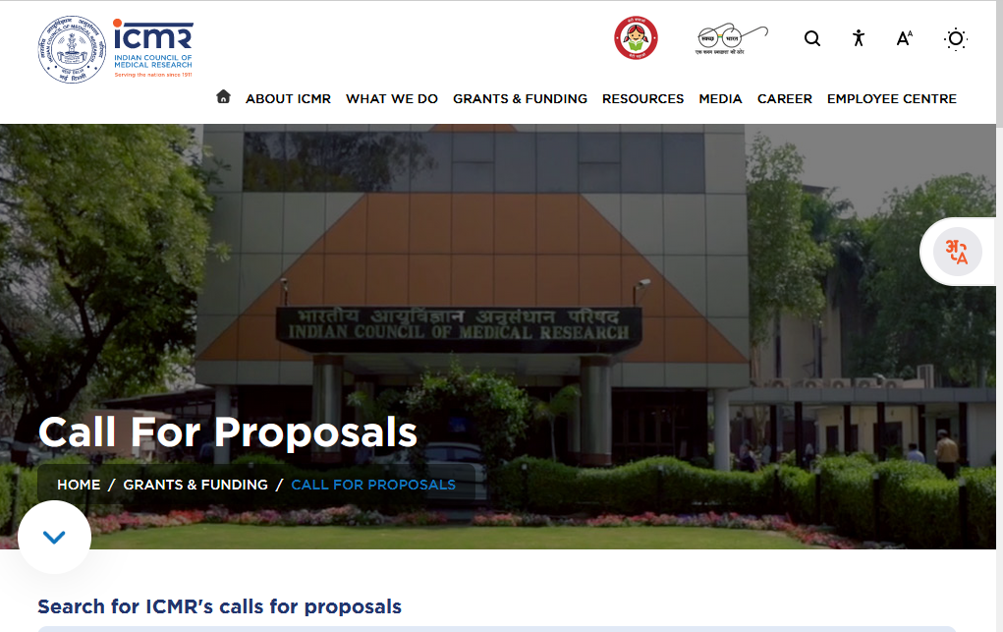

Slide 46
Grant/Scheme Name | Target Audience | Primary Focus Area | Key Deadline
STS (Short Term Studentship) | BDS (1st/2nd Yr) | UG Research Methodology (Stipend: ₹60k over 2 years) | April–May 2026 (Expected)
ANVESHAN (Small Grants) | MDS + Faculty | Investigator-initiated clinical/applied research (Up to ₹2 Cr) | March 16, 2026
NISCHAYAK (Intermediate) | Institutions/Teams | High-impact translation/Clinical trials (₹2 Cr – ₹8 Cr) | March 20, 2026

Slide 47
MDS Thesis Assistance | MDS Students | Financial support for mandatory PG thesis research | Check e-PMS Monthly
NCS Scheme | Fresh BDS/MDS | "Nurturing Clinical Scientists" – Research career pathing | Rolling/Periodic
Follow-on Grants | Previous PIs | Bridging gaps for innovations from earlier ICMR projects | March 16–20, 2026
Indo-Swiss Joint Call | International Teams | One Health, AMR, and Dental/Medical Device innovation | May 5, 2026
Clinical Care Excellence | Senior Researchers | Multi-centre trials for Non-Communicable Diseases (NCDs) | April 15, 2026

Slide 48
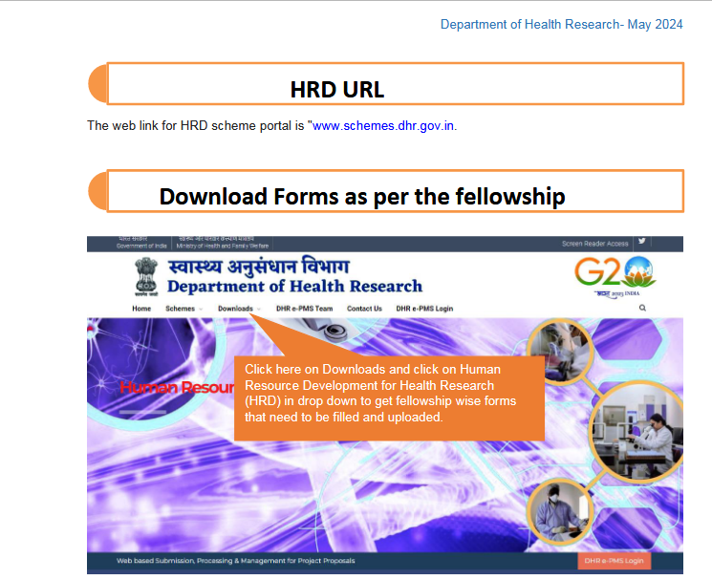

Slide 49
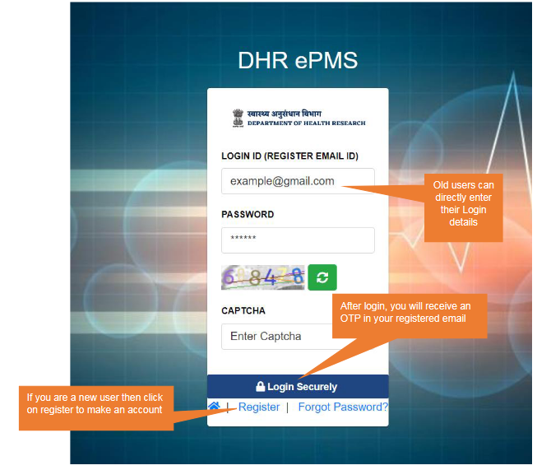
Electronic Project Management System

Slide 50

Science and Engineering Research Board (SERB)

Slide 51
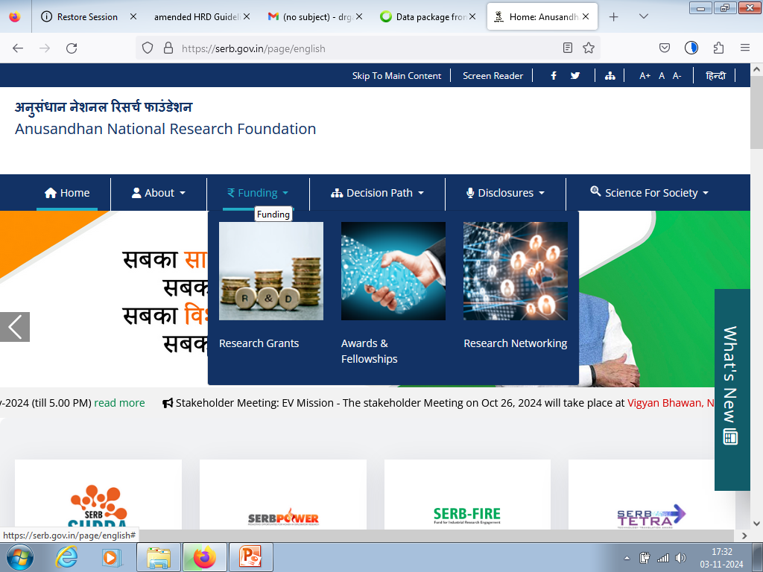

Slide 52
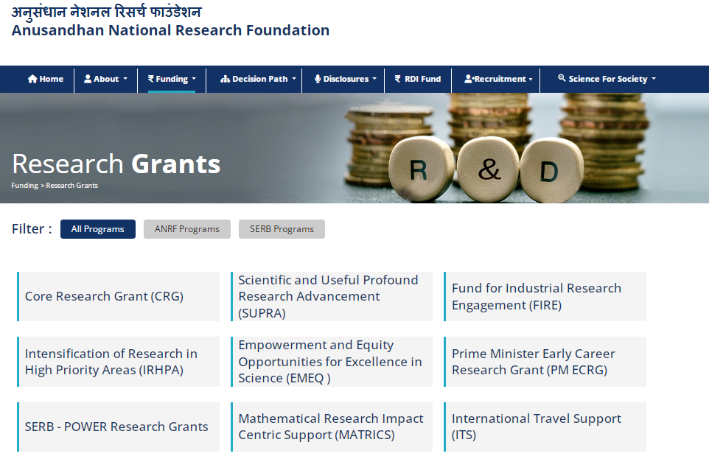
Science and Engineering Research Board (SERB)
Anusandhan National Research Foundation (ANRF)

Slide 53
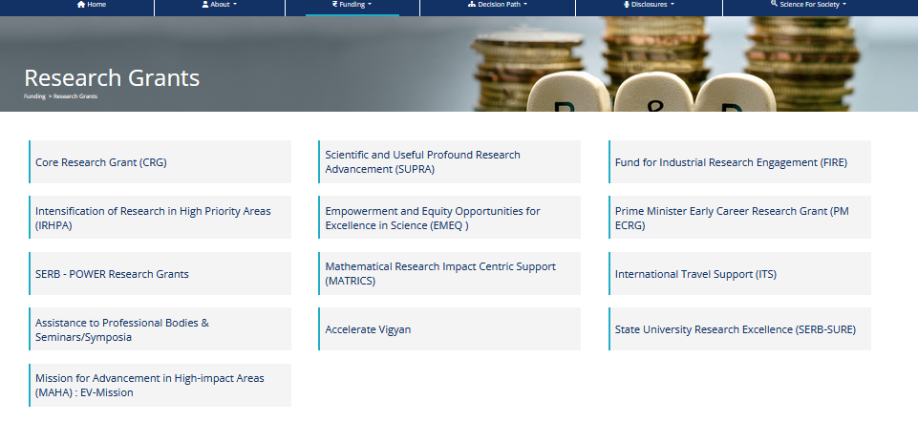

Slide 54
Science and Engineering Research Board (SERB)
Core Research Grant
SERB-SUPRA (Scientific and Useful Profound Research Advancement)
State University Research Excellence (SERB-SURE)
Intensification of Research in High Priority Areas (IRHPA)
International Travel Support (ITS) Scheme

Slide 55

CORE RESEARCH GRANT
Indian citizens hold a regular academic/research position in a recognized academic institution or national laboratory Private Academic institutions with valid UGC / AICTE / PCI approval.
The PI and Co-Investigator(s) should hold Ph.D. degree in Science, Mathematics, Engineering or M.D. / M.S. / M.D.S. / M.V.Sc. degree
Grant period of 3 years

Slide 56
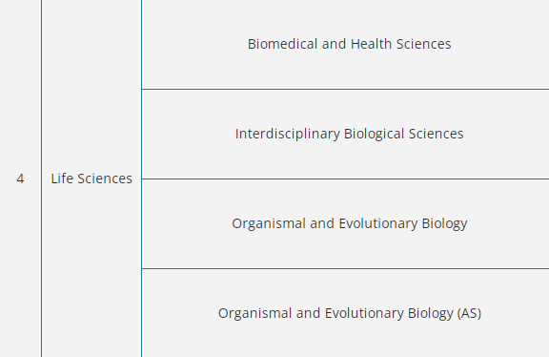
CORE RESEARCH GRANT

Slide 57
SERB-SUPRA (Scientific and Useful Profound Research Advancement)
Seeks to explore new scientific breakthroughs
With long-term impact on our fundamental scientific understanding
Offer disruptive technologies at the cutting edge

Slide 58
State University Research Excellence (SERB-SURE)
Support to active researchers belonging to state universities and colleges
PI and Co-Investigator(s) should hold Ph.D./M.D./M.S./M.D.S./M.V.Sc. degree at the time of applying for the grant.
The upper age limit is 50 years
Rs. 30 lakhs plus overheads

Slide 59
Intensification of Research in High Priority Areas (IRHPA) program
The Scheme is designed to provide major support to a few selected areas of research that have high priority from the viewpoint of advances in fundamental science and that can be of great significance for scientific and technological development.
SERB identifies the priority areas and makes a national call for seeking proposals.

Slide 60
International Travel Support (ITS) Scheme
Financial assistance to Indian researchers for presenting a research paper in an international scientific event held abroad.
In addition, support is also provided to young scientists (age limit below 35 years as on date of start of the event) for attending training programmes, Short-term schools and Workshops.
Economy class air-fare by shortest route from Air India, airport-tax and visa fees are provided under the scheme.
Registration fee as per actual or Rs. 50,000/- whichever is less will be provided to young scientist (Age < 35 on the date of start of event) in addition to the above support
Notes:
International Travel Support (ITS) Scheme provides financial assistance to Indian researchers for presenting a research paper in an international scientific event (conference, seminar, workshop etc.) held abroad. In addition, support is also provided to young scientists (age limit below 35 years as on date of start of the event) for attending training programmes, Short-term schools and Workshops. Economy class air-fare by shortest route from Air India, airport-tax and visa fees are provided under the scheme. Registration fee as per actual or Rs. 50,000/- whichever is less will be provided to young scientist (Age < 35 on the date of start of event) in addition to the above support

Slide 61
For Postdoctoral Research (MDS/Ph.D. Holders)
Scheme Name | Target Audience | Grant/Fellowship Amount | Deadline (2026)
N-PDF (National Postdoctoral Fellowship) | MDS/Ph.D. (Within 2 yrs of degree) | ₹80,000/month + HRA + ₹2 Lakh/year grant | Feb 17, 2026
Ramanujan Fellowship | MDS/Ph.D. working abroad | ₹1.35 Lakh/month + ₹7 Lakh/year grant | Rolling (Apply anytime)
SIRE (International Research Experience) | MDS/Ph.D. in permanent/temp posts | US $3000/month for 2–6 months abroad | Check Portal
WISE-PDF (Women Scientists) | Women with MDS/Ph.D. | ₹67,000/month + ₹2 Lakh/year grant | Rolling

Slide 62
For BDS Graduates (Early Career & Training
Scheme Name | Target Audience | Primary Focus | Deadline (2026)
ITS (International Travel Support) | BDS Students/Graduates | Airfare + Visa + ₹50,000 Registration for abroad events | 60-90 Days before event
PM Fellowship for Doctoral Research | BDS Grad (enrolled in Ph.D.) | Industry-sponsored Ph.D. with high monthly stipend | Rolling
Skill Vigyan | BDS Graduates | Quality training in Biotechnology/Life Science tools | Check State S&T Councils

Slide 63
For Dental Faculty (MDS)
Scheme Name | Target Audience | Funding Amount | Deadline (2026)
SRG (Start-up Research Grant) | MDS/Ph.D. (Joined within 2 years) | Up to ₹30 Lakh for 2 years | Nov - Dec 2026 (Expected)
CRG (Core Research Grant) | MDS/Ph.D. (Established faculty) | Average ₹35 Lakh for 3 years | Check Portal
MATRICS (ARG - MATRICS) | Faculty (Theoretical/Computational) | ₹2 Lakh/year for 3 years | May 8, 2026
IRG (Inclusivity Research Grant) | SC/ST category faculty | Up to ₹60 Lakh for 3 years | Nov 3, 2026
POWER Grant | Women Faculty | ₹30 Lakh to ₹60 Lakh (Level I & II) | Check Portal

Slide 64

DEPARTMENT OF SCIENCE & TECHNOLOGY

Slide 65
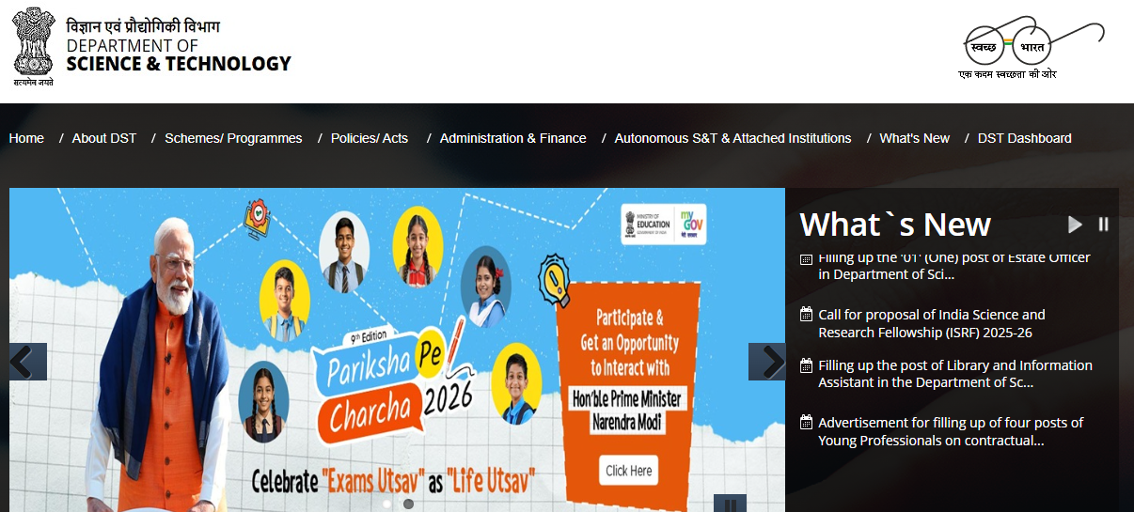
DEPARTMENT OF SCIENCE & TECHNOLOGY

Slide 66

Undergone a significant transformation recently,
Most notably with the operationalization of the Anusandhan national research foundation (ANRF).
This shift moves India's research perspective toward high-impact, industry-aligned, and mission-oriented funding

Slide 67

DST research funding landscape for 2026
Individual & Career-Based Fellowships
Institutional & Infrastructure Support
Mission-Mode & Technology Development
International Cooperation

Slide 68
Nurturing Talent (Individual Fellowships)
Early Career:
INSPIRE Ph.D. & Faculty: Attracting the top 1% of talent into basic sciences.
N-PDF: Supporting independent research post-doctorate.
Mid-to-Senior Career:
Ramanujan Fellowship: Incentivizing "Brain Gain" for researchers returning to India.
J.C. Bose Fellowship: Sustaining excellence for established, high-impact scientists.
Diversity Focus: * WISE-Ph.D.: Targeted support for women in STEM with age-flexibility.

Slide 69
Building Excellence (Infrastructure & Institutional Support
FIST (Fund for Improvement of S&T Infrastructure): Upgrading labs and equipment for modern research.
PURSE: Strengthening the research ecosystem of high-performing universities.
SATHI Centers: * The "Shared Facility" model. Centralized clusters of high-end analytical tools available to MSMEs and academia.
FIST-SHAKTI: Specific outreach to bridge the gap for Tier-2 and Tier-3 institutions.

Slide 70
Mission-Mode & Technology Development
Frontier Science Missions: Quantum Technology, AI, and Green Hydrogen.
Mission सह-SANKALP: Technology deployment for rural livelihood and aspirational districts.
The TDB Route (Technology Development Board): * Focus on Commercialization. Funding via loans and equity for scaling indigenous technologies.
Sustainability Research: Targeted programs for Waste-to-Wealth and Advanced Manufacturing.

Slide 71
Global Footprint (International Cooperation)
Bilateral Partnerships: Strategic joint calls with the UK, USA, Germany, and the EU.
Regional Leadership: * ISRF: Hosting researchers from neighboring Asian and African nations.
Global Challenges: Collaborative funding for Climate Change, Pandemic Preparedness, and Ocean Research.

Slide 72
DST- FOR DENTAL GRADUATES
While the Indian Council of Medical Research (ICMR) is the primary body for dental-specific thesis grants, the Department of Science and Technology (DST) and the newly formed ANRF offer substantial research funding for BDS and MDS students, particularly those leaning toward innovation, technology development, and academic careers.

Slide 73
For MDS Graduates
WISE-PDF (Women Scientists Scheme):
  Target: Women with an MDS (or Ph.D./MD) who want to pursue independent research.
  Grant: Approximately ₹67,000/month + HRA, plus a research grant of ₹2 Lakh/year.
  Focus: Applied sciences, including dental materials, oral cancer research, or bio-engineering.

Slide 74
For MDS Graduates
Research Associate (RA) Positions
Target: MDS degree holders.
Grant: Consolidated monthly emoluments ranging from ₹58,000 to ₹67,000 (depending on experience).
Role: You can join DST-funded projects as an RA in medical colleges or IITs working on healthcare technologies.

Slide 75
For MDS Graduates
ANRF Inclusivity Research Grant (IRG):
Target: Researchers from SC/ST categories holding an MDS or MD/Ph.D. degree.
Grant: Up to ₹60 Lakh for a 3-year project

Slide 76
For BDS Graduates
INSPIRE Fellowship:
Target: University 1st rank holders in Medicine/Healthcare (including BDS).
Purpose: To pursue a Ph.D. after your BDS degree.
S&T For Women (WISE-KIRAN):
Target: Women BDS graduates.
Grant: Fellowships for internships or projects focused on "societal relevance" (e.g., community dental health technologies).
TIDE Programme:
Focus: Technology Interventions for Disabled and Elderly.
Opportunity: BDS/MDS students can apply (usually with a faculty mentor) for projects developing assistive dental tools or geriatric dental care devices.

Slide 77
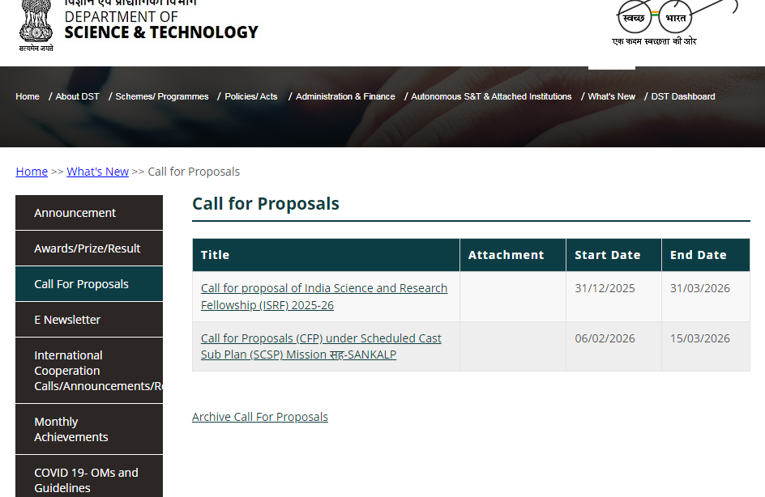

Slide 78
Program Name | Target Audience | Research Focus | Deadline
MAHA MedTech Mission | MDS/MD/Ph.D. + Industry | Dental Materials, High-cost Medical Devices, Indigenous Tech (TRL-3+) | Feb 24, 2026 (Pre-Proposal)
N-PDF (Postdoctoral) | MDS Holders (within 5 yrs) | Frontier research in Oral Oncology, Bio-materials, or Regenerative Medicine | Feb 17, 2026
Indo-Swiss (ISJRP) | Faculty / Senior PIs | One Health: Medical devices, AMR diagnostics, and Zoonotic pathogens | May 5, 2026
Mission सह-SANKALP | Faculty / NGOs | Livelihood systems, including Community Dental/Medical Health models | March 15, 2026
J.C. Bose Grant | Eminent Medical Scientists | High-impact research (nomination based) | Feb 10, 2026
ATRI (Translational) | Faculty + Industry Partner | Converting Medical/Dental prototypes into market-ready products | Feb 24, 2026

Slide 79

Streamlined Digital Portals: e-PMS and the ANRF portal for transparent tracking.
Key Success Factors for Proposals:
Multi-institutional collaboration.
Clear socioeconomic or industrial impact.
Interdisciplinary approach.
Call to Action: Aligning your research with the National Missions for higher hit rates.

Slide 80

Biotechnology industry research Assistance council

Slide 81
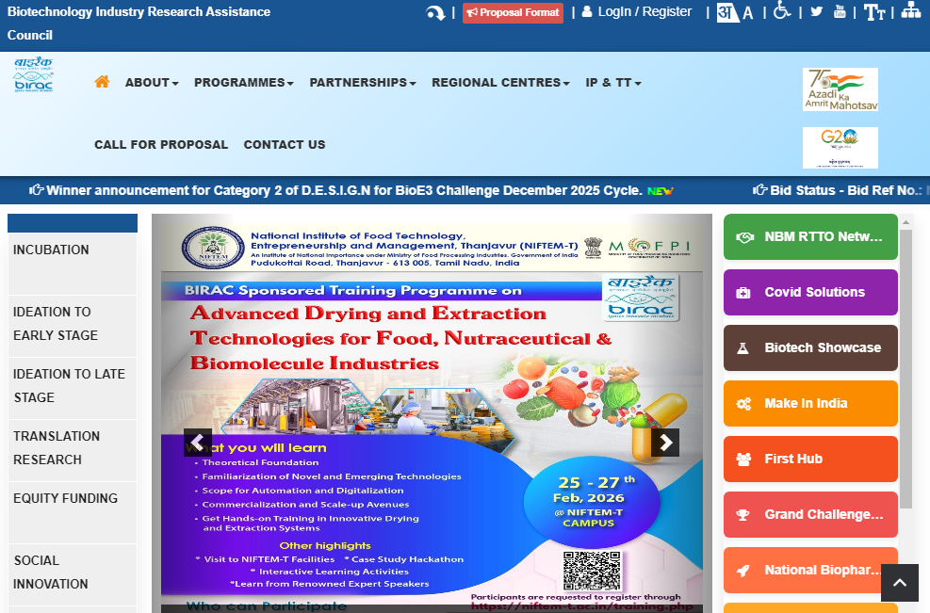
Biotechnology industry research Assistance council

Slide 82
BIRAC offers a comprehensive suite of funding schemes specifically designed for the Medical and Dental fields, ranging from early-stage student innovations to large-scale clinical trials
These opportunities are particularly vital for dental and medical professionals who often face high costs for prototypes and regulatory approvals

Slide 83
1. Flagship Grants for Healthcare Innovation
BIG (Biotechnology Ignition Grant):
Focus: Perfect for medical/dental professionals with a "bold idea" for a new device, implant, or diagnostic tool.
  Funding: Up to ₹50 Lakhs for 18 months.
  Application: Usually opens in January and July.

Slide 84
SPARSH (Social Innovation Programme for Products: Affordable & Relevant to Societal Health):
  Focus: Innovations targeting maternal and child health, aging, and waste management.
  Funding: Up to ₹50 Lakhs. This is highly relevant for dental health in rural populations or affordable medical diagnostics.
IIPME (Industry Innovation Programme on Medical Electronics):
  Focus: Specifically for medical electronics, including handheld diagnostics, wearable health gadgets, and imaging technologies (like digital intraoral sensors or portable dental X-rays).
  Funding: Varies from ₹50 Lakhs (Seed) to ₹100 Lakhs (Early Transition).

Slide 85
Specialized Mission Funding (MedTech & Biopharma)
Bio-AI Hubs (BioE3 Policy):
Focus: A new 2026 initiative for projects integrating Artificial Intelligence with healthcare.
Examples: AI-driven dental radiology analysis, robotic surgery algorithms, or predictive diagnostics for chronic diseases.
Deadline: The current rolling call for Bio-AI hubs is open until June 30, 2026

Slide 86
Student & Academic Research Support
SITARE-GYTI: Awards for innovative student projects. It provides a grant of ₹15 Lakhs to move a student project toward a startup.
E-YUVA: Provides fellowships (up to ₹50,000/month) and orientation grants to students to encourage "bench-to-bedside" research.
PACE (Promoting Academic Research Conversion to Enterprise): Specifically for faculty to collaborate with industry to validate their lab research (e.g., a new dental alloy or a drug delivery system)

Slide 87
Scheme / Mission | Primary Focus Area | Target Applicants | Funding Amount | Deadline
Bio-AI Hubs (Moolankur) | AI in Healthcare: Genome diagnostics, protein design, & Ayurveda. | Medical/Dental Colleges, Startups, & Research Hubs. | Grant-in-aid (Varies based on hub scale) | June 30, 2026
DBT-BIRAC-ICMR-SNSF Joint Call | Joint India-Switzerland research on infectious diseases & MedTech. | Clinician-Scientists & Academic Researchers. | Full Project Cost (Bilateral support) | May 5, 2026
Biopharma SHAKTI | Clinical trial site strengthening & indigenous device production. | Medical Colleges, Hospitals, & Manufacturers. | Large-scale infrastructure support | Rolling (2026-27)
BIG-26 (Extension Window) | General Biotech/MedTech innovation (Proof of Concept). | Individual Doctors/Dentists & Early Startups. | Up to ₹50 Lakhs | Check Portal (Feb 15-28 extension)
SITARE-GYTI | Student innovations in Medical/Dental/Biomedical engineering. | UG/PG/PhD Students. | ₹15 Lakhs (Grant) | Active (Check portal for dates)

Slide 88

UGC RESEARCH FUNDING
Major Research
Minor Research

Slide 89
UGC Grants Eligibility
Support to permanent/regular, working/retired teachers in the Universities and Colleges
Research project may be undertaken by an individual teacher or a group of teachers.
In case a project is undertaken jointly, one of the teachers will function as a Principal Investigator (PI) and he/she will be responsible for all matters pertaining to the project

Slide 90
Category | Scheme Name | Target Audience | Funding / Support Amount | Key Purpose
Early Career Faculty | Start-up Research Grant | Newly appointed Assistant Professors (Permanent). | ₹10 Lakhs | Initial research setup and minor equipment for new faculty.
In-Service Faculty | Research Grant for In-Service Faculty | Permanent faculty with successful Ph.D. supervision history. | ₹10 Lakhs (for 2 years) | Support for ongoing research projects, consumables, and travel.
Mid-Career Faculty | Mid-Career Award Grant | Associate Professors/Professors with at least 15 years of service. | ₹10 Lakhs | To support established researchers in pursuing new research directions.

Slide 91
Senior/Retired Faculty | UGC-BSR Faculty Fellowship | Eminent Professors nearing or post-superannuation. | ₹50,000/month + Contingency | Continuation of research and mentorship of Ph.D. students for 3 years.
Post-Doctoral Scholars | Dr. D.S. Kothari Post-Doctoral Fellowship | Ph.D./MD/MDS degree holders (under 35 years). | ₹54,000 - ₹67,000/month + HRA | Transition from a doctoral student to an independent researcher.
Doctoral Students | BSR Fellowship to Meritorious Students | Ph.D. scholars in CAS/DSA/DRS departments. | ₹37,000 - ₹42,000/month (JRF/SRF) | Financial aid to pursue full-time doctoral research in dental/medical sciences.
Women Researchers | Post-Doctoral Fellowship for Women | Unemployed female Ph.D. holders (up to 55 years). | ₹54,000 - ₹67,000/month + Contingency | Support for women to resume or advance their research careers after a break.

Slide 92
Scheme Name | Target Group | Application Status | Key Deadline / Cycle
Dr. D.S. Kothari Research Grant | Newly recruited Assistant Professors (Medical/Dental/Sciences). | OPEN | Apply within 2 years of joining.
UGC-BSR Faculty Fellowship | Eminent Professors nearing superannuation (retirement). | OPEN | Rolling (Apply 6–12 months before retirement).
Research Grant for In-Service Faculty | Regular faculty (under 50 years) with 10+ years of service left. | ACTIVE CYCLE | Annual cycle (check portal for 2026 window).
UGC-NET (JRF/SRF) | Ph.D. Scholars (including those in interdisciplinary Dental/Med research). | UPCOMING | June 2026 cycle (Notification expected April 2026).
IKS Research Centre Grants | Institutions conducting research in Indian Knowledge Systems (Ayurveda/Siddha). | ACTIVE | Check for specific theme-based extensions.
Post-Doctoral Fellowship for Women | Unemployed female PhD holders in Medical/Social Sciences. | OPEN | Annual Call (currently processing 2025-26 applications).

Slide 93
Specialized Dental Society Grants
IACDE Research Grant: (Indian Association of Conservative Dentistry and Endodontics).
ISPPD Research Assistance Grant: (Indian Society of Pedodontics and Preventive Dentistry).
ISO Research Grant: (Indian Society of Orthodontics)

Slide 94
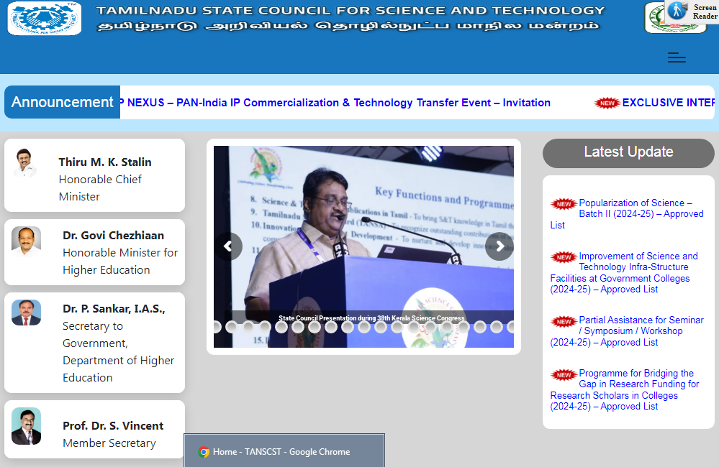

Slide 95
Scheme Name | Target Audience | Funding Amount | Key Objective
S&T Project Scheme | Faculty and Scientists (Medical/Dental/Sciences) | ₹3 - ₹5 Lakhs (for 2 years) | Support R&D with social relevance and usefulness to Tamil Nadu state.
Student Project Scheme (SPS) | Final year UG/PG students (MBBS/BDS/MDS/MD) | Up to ₹10,000 | To harness the potential of students for innovative research ideas.
Research Assistance (RFRS) | Research Scholars (Ph.D.) | Up to ₹3 Lakhs | To support Ph.D. students in colleges without sufficient central funding.
Travel Grant | Faculty and Researchers | Partial travel support | To present papers at International Conferences/Seminars.

Slide 96
Scheme Name | Expected Call Release | Submission Deadline | Evaluation/Results
Student Project Scheme (SPS) | July 2026 | August 29, 2026 | December 2026
S&T Project Scheme (Faculty) | October 2026 | November 28, 2026 | March – April 2027
Research Free Fellowship (RFRS) | September 2026 | October 2026 | January 2027
Travel Grant | Rolling (Anytime) | 3 Months before event | Within 45 days
Popularization of Science | June 2026 | July 2026 | September 2026

Slide 97


